Slide 1
Unit 7 :
Advanced data editing. Concurrence
Databases

Slide 2
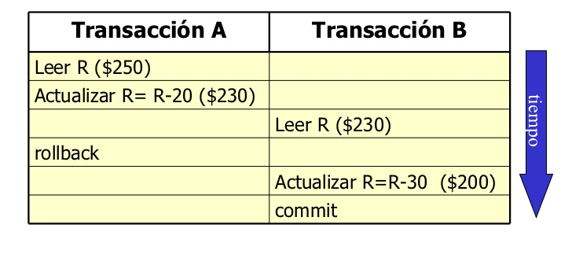
Concurrence
CONCURRENCY: Access to the same data from two or more sessions simultaneously .
CONCURRENCY PROBLEM: In some sessions data is being updated within transactions and this data is being used in other sessions. DATA CHANGED IN A TRANSACTION IS NOT CONFIRMED .

Slide 3
Concurrence
Example of a situation that can occur and that must have a solution:
Suppose that in a flight ticket booking application there is a procedure that:
look for a free seat
marks it as busy
assigns the seat to the person who made the request
It is entirely possible that at the same time two people execute the procedure simultaneously, search for the same free seat and leave the DB in an “undesirable or inconsistent” state.
Both passengers are left with the same assigned seat, the BD is left in an undesirable state.
Changes made by one operation must be isolated from changes made by other operations running at the same time. THERE MUST BE SOME LEVEL OF INSULATION

Slide 4
Concurrence
Concurrency problems when there is no isolation between transactions:
LOST UPDATE OR LOST UPDATE
DIRTY READ
PHANTOM READ
NON REPEATABLE READ

Slide 5
Concurrency Problems
LOST UPDATE OR LOST UPDATE
An update to data in one transaction is lost because another transaction changes the value of the same data. It could occur when one transaction DOES NOT READ changes made to data by another transaction.
Transaction A | Transaction B | Total_votes in A,B
SELECT total_votes FROM songs WHERE songnum=1; |  | 5, ?
 | SELECT total_votes FROM songs WHERE songnum=1; | 5.5
UPDATE songs SET total_votes=total_votes+1 WHERE songnum=1; |  | 6, 5
 | UPDATE songs SET total_votes=total_votes+1 WHERE songnum=1; | 6, 6 When doing UPDATE, 5 votes are still being read since transaction A has not been confirmed
 | COMMIT | 6, 6
COMMIT |  | 6.6

Slide 6
Concurrency Problems
DIRTY READ
It occurs when a transaction changes a piece of data but then cancels the change and before the cancellation another transaction has read the data . In B, data that was being updated has been read but said update has subsequently been reverted.
Transaction A | Transaction B | Price in A and B
Read car price 1234BCD |  | €50, ?
Increase price of car 1234BCD by 10% |  | €55, ?
 | Read car price 1234BCD | €55, €55
 | Get amount of a 2-day contract | €55, €55 The amount is €110
 | Set the contract amount in a column | €55, €55 The amount is €110
ROLLBACK |  | €50 If it were read in B it would also be €50
 | COMMIT

Slide 7
Concurrency Problems
PHANTOM READ
A transaction reads data that ceases to exist because it had been entered by another transaction that is not confirmed . In the example, a row has been read that did not exist when the transaction was started and, as a rollback is performed, that row no longer exists.
Transaction A | Transaction B
START TRANSACTION
 | START TRANSACTION
 | INSERT INTO votes (user, date, song) VALUES ('02luis', curdate(), 1) | 1 more vote for song 1
SELECT count(*) FROM votes WHERE song=1
UPDATE songs SET totalvotes = (SELECT count(*) FROM votes WHERE song=1) |  | It is assumed that the vote inserted in B also counts.
 | ROLLBACK; | The vote is annulled but it has already been counted. It was a ghost vote

Slide 8
Concurrency Problems
NON REPEATABLE READ
It happens when two or more read operations in the same transaction read different values of a piece of data because it has been modified by another. In the example total_votes are read twice and the second time it has been modified.
Transaction A | Transaction B
START TRANSACTION
SELECT total_votes FROM songs WHERE songnum=1
 | START TRANSACTION
 | UPDATE songs SET total_votes = total_votes+1 WHERE songnum=1 | Data has been modified
 | COMMIT
SELECT songnum,total_votes FROM songs; |  | It reads something different for song 1
…….

Slide 9
Coherent Readings
By default in MySQL , tables of type innodb are They make coherent readings .
This means that performing a SELECT returns the existing data in the tables up to the last completed transaction .
Thus, if when making a query, in another session or sessions there are transactions in progress that have modified the data of the table or tables that are the object of the query , the modified data will not be reflected in the result, with one exception:
If the SELECT is included in the transaction that modified the data, the modifications ARE SHOWN in the result.
Furthermore, if in a transaction the reading of data that has been modified in another transaction is repeated, the changes are not seen in the second reading, what was read in the first reading is repeated.

Slide 10
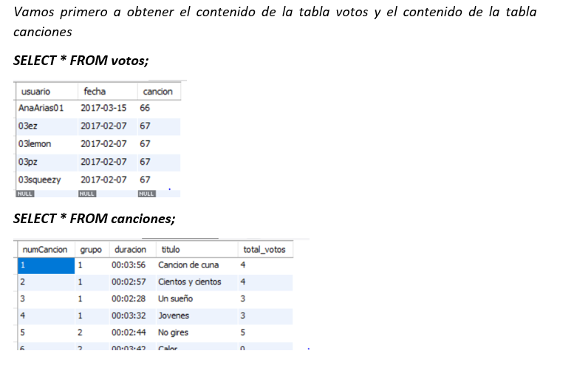
Coherent Readings
Example: We have two open MySQL client sessions that from now on we will refer to them as session 1 and session 2. In both sessions the ContestMusica database is in use . From this database, we will use the songs and votes tables.

Slide 11
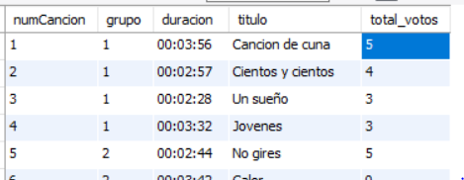
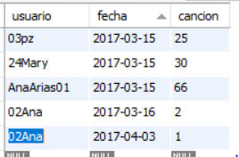
Coherent Readings
Now in session 1:
We initiate a transaction.
We register a new vote given by 02Ana for the number 1 song.
We increased the total votes for the number 1 song,
starttransaction;
insert into votes (user, date, song) values ('02Ana',curdate(),1);
update songs set total_votes=total_votes+1 where songnum=1;
In session 1 we will see the changes made, even if we have not confirmed the transaction

Slide 12

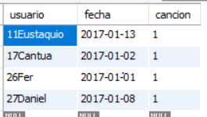
Coherent Readings
Now, without having yet confirmed the transaction, the user in session 2 checks how many votes song number 1 has and the data on the votes given to that song.
select * from songs where songnum=1;
You can't see the change made in session 1!
select * from votes where song=1;
You can't see the vote given by 02Ana!
This, which occurs by default, is the most logical given that the transaction has not been confirmed. If we now confirm the transaction in session 1 with COMMIT, we will see in session 2 the changes that were made in that transaction.

Slide 13

Coherent Readings
Example 2: Now we are going to see what happens when in session 1 we start a transaction and modify a table and, without confirming the transaction, we try to modify the same table.
In session 1 we start a transaction, we increase the total_votes of song 2 and we obtain how many votes song 2 has:
starttransaction;
update songs set total_votes=total_votes+1 where songnum=2;
SELECT * FROM songs WHERE songnum=2;

Slide 14
Coherent Readings
Now in session 2 we try to increase the total votes for song number 24 by 1.
update songs set total_votes=total_votes+1 where songnum=24;
And no problem occurs, the votes for that song are modified,
However, if in session 2 we try to increase the total votes for song 2 by 1:
update songs set total_votes=total_votes+1 where songnum=2;
The instruction remains in the running state, waiting for execution. It will not be executed until the transaction in session 1 has been committed with COMMIT or aborted with ROLLBACK. This has been the case because an attempt is being made to modify data that has been modified and not confirmed in another transaction. The other transaction has blocked access to the data that it has been modifying.

Slide 15
Read locks in shared mode
In a query with read blocking in shared mode , a result is not obtained if a transaction in another session has modified data used in the query. The result is obtained when the transaction is completed.
Example: In session 1 we start a transaction and add a new record in the votes table to indicate that 20Luis has voted for song 3.
insert into votes (user, date, song) values ('20Luis',curdate(),3);
Now in session 2 we perform a query with read blocking in shared mode to count how many votes song 3 has in the votes table:
select count(*) from votes where song=3 lock in share mode;
You will not get a result until the transaction is completed. When the transaction ends, the query will complete .

Slide 16
Table locks
Using InnoDB type tables, as we have seen, locks occur at the record level or at the row level.
MySQL has another type of lock, table locking , available on all table types including MyISAM and, of course, also on InnoDB. There are two types of locks:
Read: the session that has the table locked can read but not write. Several sessions can exercise this lock on the same table at the same time. Other sessions that do not have it locked can read as well.
Write: The session that has the table locked can read and write. The rest of the sessions cannot read or write.
The syntax to lock a table is:
LOCK TABLE tablename READ|WRITE

Slide 17
Table locks
Table Lock Example 1:
In session 1 a read lock is placed on the votes table and a vote is added to that table:
LOCK TABLE votes READ;
insert into votes (user, date, song) values ('27Daniel',curdate(),5);
It cannot be inserted even in the session in which the lock was made. The error occurs:
Error Code: 1099. Table 'votes' was locked with a READ lock and can't be updated
But we can do, both in session 1 and in other simultaneous sessions:
select song,count(*) from votes group by song;

Slide 18
Table locks
Table Lock Example 1 (continued):
If in session 2, we try to perform an update on the votes table, for example:
update votes set song=7 where song=3;
The instruction waits for execution . Its execution is not completed until the table is unlocked.
To be able to make updates to the votes table again, you will have to unlock it:
UNLOCK TABLES;
When a lock is created to access a table, within the lock zone we will not be able to access other tables until the lock is finalized:
LOCK TABLE votes READ;
SELECT * FROM votes;
SELECT * FROM songs; This line will give us an error

Slide 19
Table locks
Table Lock Example 2:
In session 1 a write lock is placed on the votes table and a vote is added to that table:
LOCK TABLE votes WRITE;
insert into votes (user, date, song) values ('16Victor',curdate(),5);
The update is allowed to be performed within the session in which the crash occurred.
We obtain the data of all the votes:
select * from votes;
The query is allowed to be made within the session in which the blocking occurred.

Slide 20
Table locks
Table Lock Example 2 (continued):
In session 1 a write lock was made in the votes table.
LOCK TABLE votes WRITE;
If we perform the query in session 2:
SELECT * FROM votes;
The instruction waits for execution . Its execution is not completed until the table is unlocked. The same would happen with an update instruction.

Slide 21
Isolation levels
Depending on the level of concurrency desired, it is possible to request 4 levels of isolation from the DBMS.
•An isolation level defines how changes made by a transaction are visible to other transactions.
The isolation levels that MySQL offers us are the following:
• SERIALIZABLE
• REPEATABLE READ In MysQl the InnBD tables have this level by default.
• READ COMMITTED
• READ UNCOMMITTED

Slide 22
Isolation levels
SERIALIZABLE: Each transaction occurs in complete isolation from other transactions. There is never attendance.
REPEATEABLE READ It consists of if a record read with a SELECT in one transaction is modified and confirmed in another transaction, a new read in the first transaction repeats the result that was initially generated.
READ COMMITTED: Data read by one transaction can be modified by other transactions. A transaction will not read data that has not been committed by the commit of another transaction.
READ UNCOMMITTED: SELECT statements are carried out without blocking, therefore, all changes made by a transaction can be seen by other transactions.
How to change the isolation level?
SET TRANSACTION ISOLATION LEVEL
{READ UNCOMMITTED | READ COMMITTED | REPEATABLE READ | SERIALIZABLE}

